Slide 1
Multi Layer Perceptron & Backpropagation

Slide 2
Outline
The Perceptron Learning Rule and the Perceptron Convergence Theorem (revisited)
The continuous perceptron and the delta learning rule (gradient descent)
Multi layer perceptron (discrete and continuous)
Learning with hidden units and Backpropagation
Applications
Overfitting vs. generalization
Network design & training
The Universal Approximation Property

Slide 3
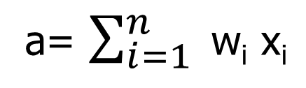
The Discrete Perceptron (Threshold Logic Unit (TLU)
inputs
weights
x₁
w₁
output
w₂
activation
x₂
Σ
y
.
.
.
a= $\sum_{i=1}^{n}{ }$w_{i} x_{i}
θ
w_{n}
x_{n}
{
1 if a ≥ θ
y =
0 if a < θ
we use in this example the unipolar sgn function

Slide 4
Decision Surface of a TLU
1
1
Decision line
w₁ x₁ + w₂ x₂ = θ
x₂
w
1
0
0
0
x₁
1
0
0

Slide 5
Geometric Interpretation
The relation w•x=θ defines the decision line
x₂
w
Decision line
y=1
w•x=θ
|x_{w}|=θ/|w|
x_{w}
x₁
x
y=0

Slide 6
Geometric Interpretation
In n dimensions the relation w•x=θ defines a n-1 dimensional hyperplane, which is perpendicular to the weight vector w.
On one side of the hyperplane (w•x>θ) all patterns are classified by the TLU as “1”, while those that get classified as “0” lie on the other side of the hyperplane.
If patterns can be not separated by a hyperplane, then they cannot be correctly classified with a TLU.

Slide 7
Threshold as Weight
θ=w_{n+1}
x_{n+1}= -1
x₁
w₁
w_{n+1}
w₂
x₂
Σ
y
.
.
.
w_{n}
{
x_{n}
1 if a ≥ 0
y=
0 if a <0

Slide 8
Training ANNs
Training set S of examples {x, t}
x is an input vector and
t the desired target vector
Example: Logical AND
S = {(0,0),0}, {(0,1),0}, {(1,0),0}, {(1,1),1}
Iterative process
Present a training example x , compute network output y , compare output y with target t, adjust weights and thresholds
Learning rule
Specifies how to change the weights w and thresholds θ of the network as a function of the inputs x, output y and target t.

Slide 9
Perceptron Learning Rule
w’=w + α (t-y) x
Or in components
w’_{i} = w_{i} + Δw_{i} = w_{i} + α (t-y) x_{i} (i=1..n+1)
With w_{n+1} = θ and x_{n+1}= -1
The parameter α is called the learning rate. It determines the magnitude of weight updates Δw_{i} .
If the output is correct (t=y) the weights are not changed (Δw_{i} =0).
If the output is incorrect (t ≠ y) the weights w_{i} are changed such that the output of the TLU for the new weights w’_{i} is closer/further to the input x_{i}.

Slide 10
Perceptron Training Algorithm
Repeat
for each training vector pair (x,t)
evaluate the output y when x is the input
if y≠t then
form a new weight vector w’ according
to w’=w + α (t-y) x
else
do nothing
end if
end for
Until y=t for all training vector pairs

Slide 11
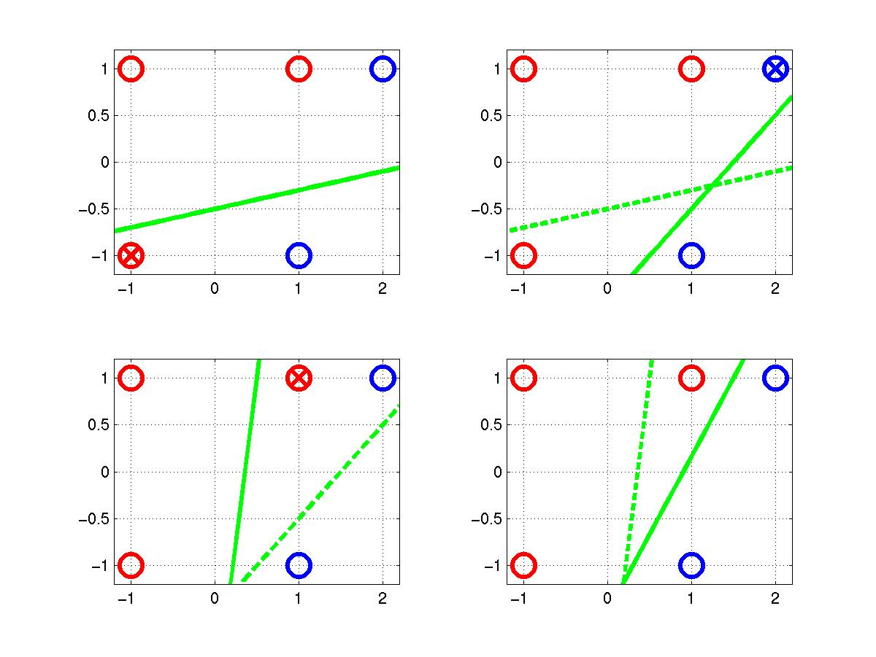
Perceptron Learning Rule
t=-1
t=1
o=1
w=[0.25 –0.1 0.5]
x₂ = 0.2 x₁ – 0.5
o=-1
(x,t)=([2,1],-1)
o=sgn(0.45-0.6+0.3)
=1
(x,t)=([-1,-1],1)
o=sgn(0.25+0.1-0.5)
=-1
(x,t)=([1,1],1)
o=sgn(0.25-0.7+0.1)
=-1
Δw=[0.2 –0.2 –0.2]
Δw=[-0.2 –0.4 –0.2]
Δw=[0.2 0.2 0.2]

Slide 12
Perceptron Convergence Theorem
The algorithm converges to the correct classification if the training data is linearly separable and α is sufficiently small.
If two classes of vectors x₁ and x₂ are linearly separable, the application of the perceptron training algorithm will eventually result in a weight vector w₀, such that w₀ defines a TLU whose decision hyper-plane separates x₁ and x₂ (Rosenblatt 1962).
Solution w₀ is not unique, since if w₀ x =0 defines a hyper-plane, so does w’₀ = k w₀.

Slide 13
Multiple TLUs
Handwritten alphabetic character recognition
26 classes : A,B,C…,Z
First TLU distinguishes between “A”s and “non-A”s, second TLU between “B”s and “non-B”s etc.
. . .
y₁
y₂
y₂₆
w_{ji} connects x_{i} with y_{j}
x₁
x₂
x₃
. . .
x_{n}
w’_{ji} = w_{ji} + α (t_{j}-y_{j}) x_{i}

Slide 14
Gradient Descent Learning Rule (for the continuous perceptron)
Consider the linear activation function, without threshold and continuous output y:
y = w₀ + w₁ x₁ + … + w_{n} x_{n}
Train the w_{i}’s such that they minimize the squared error:
E[w₁,…,w_{n}] = ½ Σ_{d∈D} (t_{d}-y_{d})²
where D is the set of training samples

Slide 15
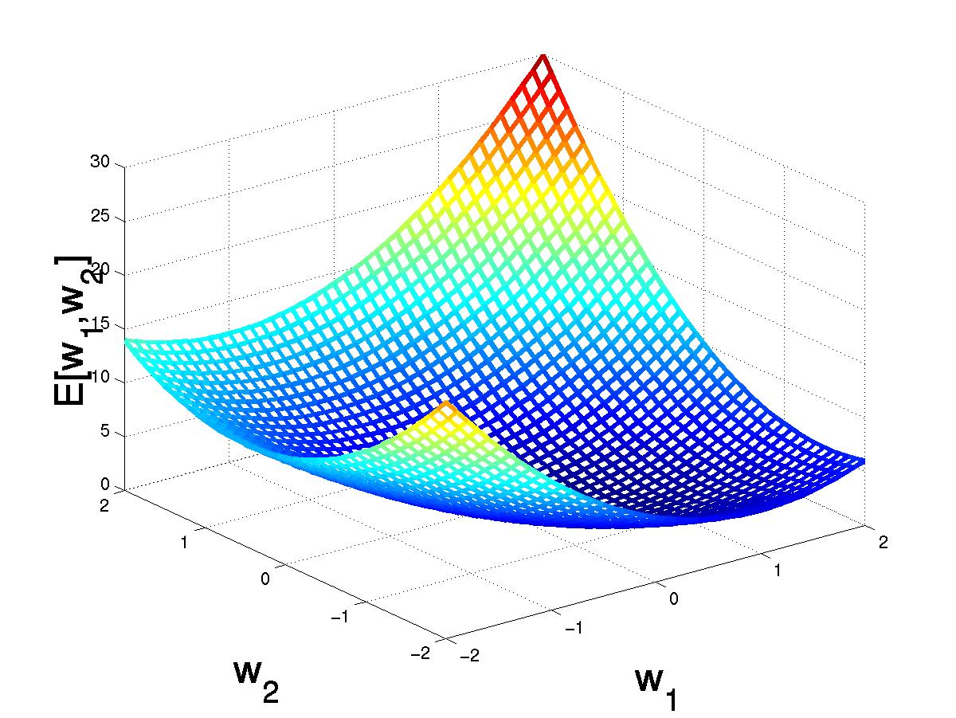
Gradient Descent
D={<(1,1),1>,<(-1,-1),1>,
<(1,-1),-1>,<(-1,1),-1>}
(w₁,w₂)
Gradient:
∇E[w]=[∂E/∂w₀,… ∂E/∂w_{n}]
Δw=-η ∇E[w]
(w₁+Δw₁,w₂ +Δw₂)
Δw_{i}=-η ∂E/∂w_{i}
=∂/∂w_{i} 1/2Σ_{d}(t_{d}-y_{d})²
= ∂/∂w_{i} 1/2Σ_{d}(t_{d}-Σ_{i} w_{i} x_{i})²
= Σ_{d}(t_{d}-y_{d})(-x_{i})

Slide 16
Incremental Stochastic Gradient Descent
Batch mode : gradient descent
w = w - η ∇E_{D}[w] over the entire data D
E_{D}[w] = 1/2 Σ_{d}(t_{d}-y_{d})²
Incremental mode: gradient descent
w = w - η ∇E_{d}[w] over individual training examples d
E_{d}[w] = 1/2 (t_{d}-y_{d})²
Incremental Gradient Descent can approximate Batch Gradient Descent arbitrarily closely if η is small enough.

Slide 17
Perceptron vs. Gradient Descent Rule (p is the index of the training vector)
perceptron rule
w’_{i} = w_{i} + α (t^{p}-y^{p}) x_{i}^{p}
derived from manipulation of decision surface.
gradient descent rule
w’_{i} = = w_{i} - η ∂E/∂w_{i}
derived from minimization of error function
E[w₁,…,w_{n}] = ½ Σ_{p} (t^{p}-y^{p})²
by means of gradient descent.
Where is the big difference?

Slide 18
Perceptron vs. Gradient Descent Rule
Perceptron learning rule guaranteed to succeed if:
Training examples are linearly separable
Sufficiently small learning rate α
Linear unit training rules uses gradient descent:
Guaranteed to converge to hypothesis with minimum squared error
Given sufficiently small learning rate η
Even when training data contains noise
Even when training data not linearly separable

Slide 19
Neuron with Sigmoid-Function
inputs
weights
x₁
w₁
output
w₂
activation
x₂
Σ
y
.
.
.
net=Σ_{i} w_{i} x_{i}
w_{n}
x_{n}
y=σ(net) =1/(1+e^{-net})
(For the unipolar sigmoid function)
Note: We take λ = 1

Slide 20
Sigmoid Unit
x₀₌-1
x₁
w₁
w₀
w₂
x₂
Σ
y
.
.
.
w_{n}
σ(x) is the sigmoid function: 1/(1+e^{-x})
dσ(x)/dx= σ(x) (1- σ(x))
x_{n}
Derive gradient decent rules to train:
one sigmoid function
∂E/∂w_{i} = -Σ_{p}(t^{p}-y^{p}) y (1-y^{p}) x_{i}^{p}
Multilayer networks of sigmoid units
backpropagation

Slide 21
Gradient Descent Rule for Sigmoid Output Function
σ
sigmoid
E^{p}[w₁,…,w_{n}] = ½ (t^{p}-y^{p})²
∂E^{p}/∂w_{i} = ∂/∂w_{i} ½ (t^{p}-y^{p})²
= ∂/∂w_{i} ½ (t^{p}- σ(Σ_{i} w_{i} x_{i}^{p}))²
= (t^{p}-y^{p}) σ‘(Σ_{i} w_{i} x_{i}^{p}) (-x_{i}^{p})
for y= 1/(1+e^{-net})
σ’(net)= e^{-net}/(1+e^{-net})²=σ(net) (1-σ(net))
net
σ’
net
w’_{i}= w_{i} + Δw_{i} = w_{i} + η y^{p} (1-y^{p})(t^{p}-y^{p}) x_{i}^{p}

Slide 22
Gradient Descent Learning Rule for the unipolar sigmoid function
Δw_{i} = η y_{j}^{p}(1-y_{j}^{p}) (t_{j}^{p}-y_{j}^{p}) x_{i}^{p}
activation of
pre-synaptic neuron
learning rate
derivative of
activation function
error δ_{j} of
post-synaptic neuron

Slide 23
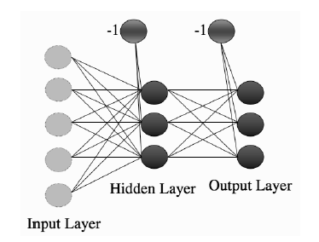
Multi-Layer Perceptron

Slide 24
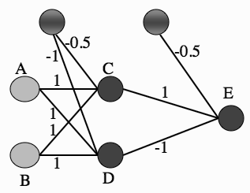
A Multi-layer Perceptron network showing a set of weights that solve the XOR problem

Slide 25
Learning with hidden units
Networks without hidden units are very limited in the input-output mappings they can model.
More layers of linear units do not help. It’s still linear.
Fixed output non-linearities are not enough
We need multiple layers of adaptive non-linear hidden units. This gives us a universal approximator. But how can we train such nets?
We need an efficient way of adapting all the weights, not just the last layer. This is hard. Learning the weights going into hidden units is equivalent to learning features.
Nobody is telling us directly what hidden units should do.

Slide 26
The idea behind backpropagation
We don’t know what the hidden units ought to do, but we can compute how fast the error changes as we change a hidden activity.
Instead of using desired activities to train the hidden units, use error derivatives w.r.t. hidden activities.
Each hidden activity can affect many output units and can therefore have many separate effects on the error. These effects must be combined.
We can compute error derivatives for all the hidden units efficiently.
Once we have the error derivatives for the hidden activities, its easy to get the error derivatives for the weights going into a hidden unit.

Slide 27
Backpropagation
y_{j}
Backward step:
propagate errors from output to hidden layer
δ_{j}
w_{jk}
x_{k}
δ_{k}
w_{ki}
Forward step:
Propagate activation
from input to output layer
x_{i}

Slide 28
Training-Rule for Weights to the Output Layer
E^{p}[w_{ij}] = ½ Σ_{j} (t_{j}^{p}-y_{j}^{p})²
y_{j}
∂E^{p}/∂w_{ji} = ∂/∂w_{ji} ½ Σ_{j} (t_{j}^{p}-y_{j}^{p})²
= …
= - y_{j}^{p}(1-y^{p}_{j})(t^{p}_{j}-y^{p}_{j}) x_{i}^{p}
w_{ji}
x_{i}
Δw_{ji} = η y_{j}^{p}(1-y_{j}^{p}) (t^{p}_{j}-y_{j}^{p}) x_{i}^{p}
= η δ_{j}^{p} x_{i}^{p}
with δ_{j}^{p} := y_{j}^{p}(1-y_{j}^{p}) (t^{p}_{j}-y_{j}^{p})

Slide 29
Training-Rule for Weights to the Hidden Layer
δ_{j}
y_{j}
Credit assignment problem:
No target values t for hidden layer
units.
w_{jk}
x_{k}
δ_{k}
Error for hidden units?
δ_{k} = Σ_{j} w_{jk} δ_{j} y_{j}^{p} (1-y_{j}^{p})
w_{ki}
Δw_{ki} = η x_{k}^{p}(1-x_{k}^{p}) δ_{k}^{p} x_{i}^{p}
x_{i}

Slide 30
Training-Rule for Weights to the Hidden Layer
δ_{j}
y_{j}
E^{p}[w_{ki}] = ½ Σ_{j} (t_{j}^{p}-y_{j}^{p})²
w_{jk}
∂E^{p}/∂w_{ki} = ∂/∂w_{ki} ½ Σ_{j} (t_{j}^{p}-y_{j}^{p})²
=∂/∂w_{ki} ½Σ_{j} (t_{j}^{p}-σ(Σ_{k}w_{jk} x_{k}^{p}))²
=∂/∂w_{ki} ½Σ_{j} (t_{j}^{p}-σ(Σ_{k}w_{jk} σ(Σ_{i}w_{ki} x_{i}^{p})))²
= -Σ_{j} (t_{j}^{p}-y_{j}^{p}) σ’_{j}(net) w_{jk} σ’_{k}(net) x_{i}^{p}
= -Σ_{j} δ_{j} w_{jk} σ’_{k}(net) x_{i}^{p}
= -Σ_{j} δ_{j} w_{jk} x_{k} (1-x_{k}) x_{i}^{p}
x_{k}
δ_{k}
w_{ki}
x_{i}
Δw_{ki} = η δ_{k} x_{i}^{p}
with δ_{k} = Σ_{j} δ_{j} w_{jk} x_{k}^{p} (1- x_{k}^{p})

Slide 31
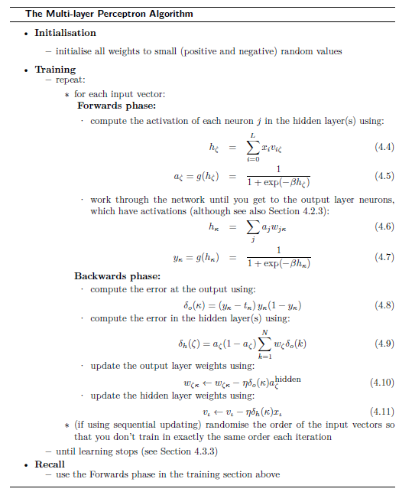

Slide 32
Backpropagation
Gradient descent over entire network weight vector
Will find a local, not necessarily global error minimum
-in practice often works well (can be invoked multiple times with different initial weights)
Minimizes error training examples
Will it generalize well to unseen instances (over-fitting)?
Training can be slow typical 1000-10000 iterations (use Levenberg-Marquardt instead of gradient descent!)
Using network after training is fast!

Slide 33
Convergence of Backpropagation
Gradient descent to some local minimum perhaps not global minimum
Add momentum term:
Δw_{ki}(n) = η δ_{k}(n) x_{i}^{p} (n) + α Δw_{ki}(n-1), with α ∈ [0,1], where Δw_{ki}(n-1) is the previous increment.
Stochastic gradient descent
Train multiple nets with different initial weights
Nature of convergence
Initialize weights near zero
Therefore, initial networks near-linear
Increasingly non-linear functions possible as training progresses

Slide 34
Ways to use weight derivatives
How often to update
after each training case?
after a full sweep through the training data?
How much to update
Use a fixed learning rate?
Adapt the learning rate?
Add momentum?
Don’t use steepest descent?

Slide 35
Early Applications of Neural Networks
Alvinn (the neural network that learns to drive a van from camera inputs)
NETtalk: a network that learns to pronounce English text.
Recognizing hand-written zip codes
Lots of applications in financial time series analysis

Slide 36
ALVINN
Automated driving at 70 mph on a public highway
Camera
image
30 outputs
for steering
30x32 weights
into one out of
four hidden
unit
4 hidden
units
30x32 pixels
as inputs

Slide 37
NETtalk (Sejnowski & Rosenberg, 1987)
The task is to learn to pronounce English text from examples.
Training data is 1024 words from a side-by-side English/phoneme source.
Input: 7 consecutive characters from written text presented in a moving window that scans text.
Output: phoneme code giving the pronunciation of the letter at the center of the input window.
Network topology: 7x29 inputs (26 chars + punctuation marks), 80 hidden units and 26 output units (phoneme code). Sigmoid units in hidden and output layer.

Slide 38
NETtalk
Training protocol: 95% accuracy on training set after 50 epochs of training by full gradient descent. 78% accuracy on a set-aside test set.
Comparison against Dectalk (a rule based expert system): Dectalk performs better; it represents a decade of analysis by linguists. NETtalk learns from examples alone and was constructed with little knowledge of the task.

Slide 39
Overfitting
The training data contains information about the regularities in the mapping from input to output. But it also contains noise
The target values may be unreliable.
There is sampling error. There will be accidental regularities just because of the particular training cases that were chosen.
When we fit the model, it cannot tell which regularities are real and which are caused by sampling error.
So, it fits both kinds of regularity.
If the model is very flexible it can model the sampling error really well. This is a disaster.

Slide 40
A simple example of overfitting
Which model do you believe?
The complicated model fits the data better.
But it is not economical
A model is convincing when it fits a lot of data surprisingly well.
It is not surprising that a complicated model can fit a small amount of data.

Slide 41
Generalization
The objective of learning is to achieve good generalization to new cases, otherwise just use a look-up table.
Generalization can be defined as a mathematical interpolation or regression over a set of training points:
f(x)
x

Slide 42
Generalization
An Example: Computing Parity
Can it learn from m examples to generalize to all 2^n possibilities?
Parity bit value
+1
-1
+1
>0
>1
>2
(n+1)^2
weights
n bits of input
2^n possible examples

Slide 43
Generalization
Network test of 10-bit parity
(Denker et. al., 1987)
100%
Test
Error
When number of training cases >> number of weights, then generalization occurs
0
.25
.50
.75
1.0
Fraction of cases used during training

Slide 44
Generalization
Over-Training
Is the equivalent of over-fitting a set of data points to a curve which is too complex.
Occam’s Razor: “plurality should not be assumed without necessity”.
Occam's razor (law of parsimony) is the problem-solving principle that, when presented with competing hypothetical answers to a problem, one should select the one that makes the fewest assumptions. The idea is attributed to William of Ockham (c. 1287–1347), who was an English Franciscan friar, scholastic philosopher, and theologian.
The simplest model which explains the majority of the data is usually the best.
Notes:
Show over-training OH

Slide 45
Generalization
Prevent Over-training using Regularization Techniques:
Use a separate test or tuning set of examples
Monitor error on the test set as network trains
Stop network training just prior to over-fit error occurring - early stopping or tuning
Number of effective weights is reduced
Most new systems have automated early stopping methods

Slide 46
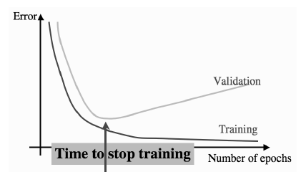
The effect of overfitting on the training and validation error curves, with the point at which early stopping will stop the learning marked

Slide 47
Generalization
Weight Decay: an automated method of effective weight control
Adjust the error function to penalize the growth of unnecessary weights:
E = ½ Σ_{p} (t^{p}-y^{p})² + λ/2 w^{t} • w
where: λ (weight-cost parameter) is decayed by an amount proportional to the weight’s magnitude

Slide 48
Network Design & Training Issues
Design:
Architecture of network
Structure of artificial neurons
Learning rules
Training:
Ensuring optimum training
Learning parameters
Data preparation
and more ....

Slide 49
Network Design
Architecture of the network: How many nodes?
Determines number of network weights
How many layers?
How many nodes per layer?
Input Layer Hidden Layer Output Layer
? ? ?
Automated methods:
augmentation (cascade correlation)
weight pruning and elimination

Slide 50
Network Design
Selecting a Learning Rule
Generalized delta rule (steepest descent)
Momentum descent
Advanced weight space search techniques

Slide 51
Network Training
How do you ensure that a network has been well trained?
Objective: To achieve good generalization
accuracy on new examples/cases.
Establish a maximum acceptable error rate.
Train the network using a validation set to tune it.
Validate the trained network against a separate test set which is usually referred to as a test set.

Slide 52
Network Training
Approach #1: Large Sample
When the amount of available data is large ...
Available Examples
70%
Divide randomly
30%
Training
Set
Production
Set
Generalization error
= test error
Test
Set
Compute
Test error
Used to develop one NN model

Slide 53
Network Training
Approach #2: Cross-validation
When the amount of available data is small ...
Available Examples
Repeat 10
times
90%
10%
Test
Set
Generalization error
determined by mean
test error and stddev
Training
Set
Pro.
Set
Used to develop 10 different NN models
Accumulate
test errors

Slide 54
Network Training
How do you select between two NN designs?
A statistical test of hypothesis is required to ensure that a significant difference exists between the error rates of two NN models
If Large Sample method has been used, then apply McNemar’s test*
If Cross-validation then use a paired t test for difference of two proportions
*We assume a classification problem, if this is function approximation then use paired t test for difference of means.

Slide 55
Network Training
Mastering NN Parameters
Typical Range
learning rate: η 0.1 0.01 - 0.99
momentum: α 0.8 0.1 - 0.9
weight-cost: λ 0.1 0.001 - 0.5
Fine tuning :
adjust individual parameters at each node and/or connection weight
automatic adjustment during training

Slide 56
Network Training
Network weight initialization
Random initial values +/- some range
Smaller weight values for nodes with many incoming connections
Rule of thumb: initial weight range should be approximately ±1/ (# weights) coming into a node

Slide 57
Network Training
Typical Problems During Training
E
Steady, rapid decline
in total error
Would like:
# iter
E
Seldom a local minimum - reduce learning or momentum parameter
But
sometimes:
# iter
E
Reduce learning parms.
- may indicate data is not learnable
# iter

Slide 58
How To Improve The Standard Backpropagation Algorithm
Read:
http://yann.lecun.com/exdb/publis/pdf/lecun-98b.pdf

Slide 59
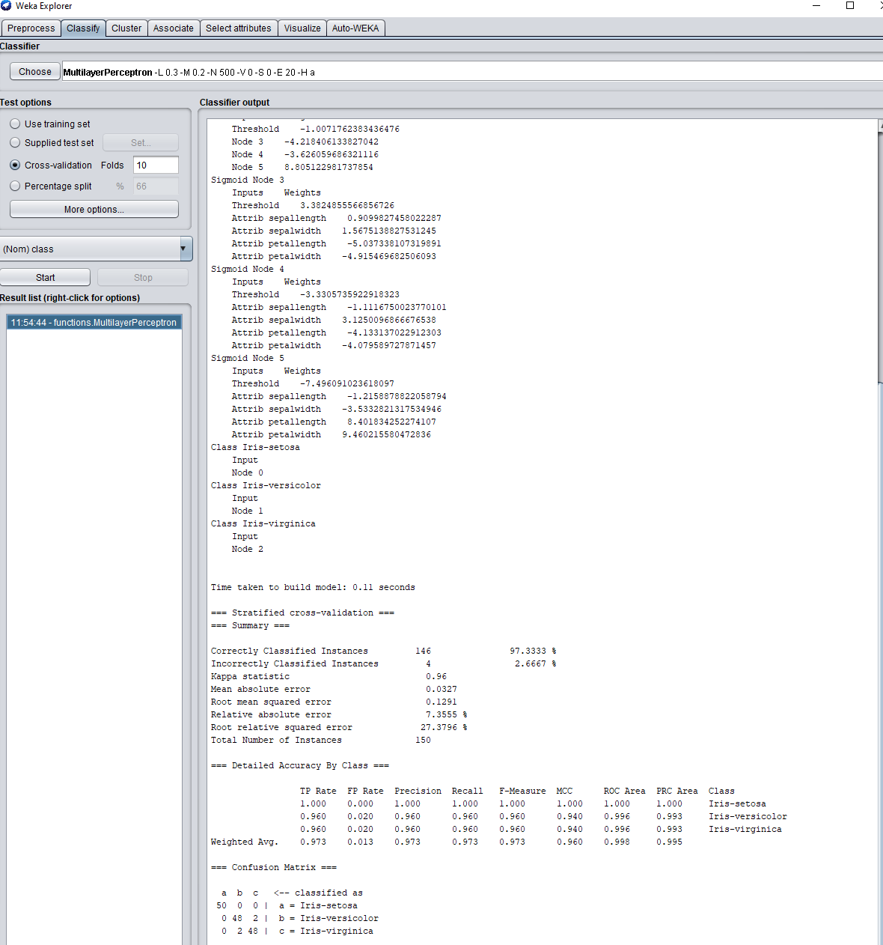
MLP in WEKA

Slide 60
Multilayer Perceptron with TensorFlow 2.0 and Keras
# Imports
import tensorflow
from tensorflow.keras.datasets import mnist
from tensorflow.keras.models import Sequential
from tensorflow.keras.layers import Dense
from tensorflow.keras.utils import to_categorical
# Configuration options
feature_vector_length = 784
num_classes = 10
# Load the data
(X_train, Y_train), (X_test, Y_test) = mnist.load_data()
# Reshape the data - MLPs do not understand such things as '2D'.
# Reshape to 28 x 28 pixels = 784 features
X_train = X_train.reshape(X_train.shape[0], feature_vector_length)
X_test = X_test.reshape(X_test.shape[0], feature_vector_length)
# Convert into greyscale
X_train = X_train.astype('float32')
X_test = X_test.astype('float32')
X_train /= 255
X_test /= 255
# Convert target classes to categorical ones
Y_train = to_categorical(Y_train, num_classes)
Y_test = to_categorical(Y_test, num_classes)
# Set the input shape
input_shape = (feature_vector_length,)
print(f'Feature shape: {input_shape}')
# Create the model
model = Sequential()
model.add(Dense(350, input_shape=input_shape, activation='relu'))
model.add(Dense(50, activation='relu'))
model.add(Dense(num_classes, activation='softmax'))
# Configure the model and start training
model.compile(loss='categorical_crossentropy', optimizer='adam', metrics=['accuracy'])
model.fit(X_train, Y_train, epochs=10, batch_size=250, verbose=1, validation_split=0.2)
# Test the model after training
test_results = model.evaluate(X_test, Y_test, verbose=1)
print(f'Test results - Loss: {test_results[0]} - Accuracy: {test_results[1]}%')
(used to classify on the MNIST dataset)

Slide 61
NN: Universal Approximator?
Kolmogorov proved that any continuous function g(x) defined on the unit hypercube I^{n} can be represented as for properly chosen and .
(A. N. Kolmogorov. On the representation of continuous functions of several variables by superposition of continuous functions of one variable and addition. Doklady Akademiia Nauk SSSR, 114(5):953-956, 1957)

Slide 62
Universal Approximation Property of ANN
Boolean functions
Every boolean function can be represented by network with single hidden layer
But might require exponential (in number of inputs) hidden units
Continuous functions
Every bounded continuous function can be approximated with arbitrarily small error, by network with one hidden layer [Cybenko 1989, Hornik 1989]
Any function can be approximated to arbitrary accuracy by a network with two hidden layers [Cybenko 1988]

Slide 63
A visual proof that neural nets can compute any function
http://neuralnetworksanddeeplearning.com/chap4.html

Slide 64
My own results on Universal Function Approximation
Sasu L., Andonie R. Bayesian ARTMAP for Regression, Neural Networks, 46, 2013, 23-31.

